Slide 1
EMOTIVE
Multimodal Emotion Recognition System
Review 4
Real-time fusion of facial & audio emotion detection | EfficientNet + LSTM

Slide 2
PROJECT OVERVIEW
Problem Statement
Our Solution
Existing emotion recognition systems depend on a single modality — either facial expression or voice — making them prone to failure when that modality is noisy or ambiguous. A multimodal approach that fuses both signals produces more robust and accurate predictions in real-world conditions.
EfficientNet-B0 trained on FER-2013 for facial emotion
LSTM trained on RAVDESS for audio emotion
Live Streamlit app with webcam + microphone
7 emotion classes detected in real time

Slide 3
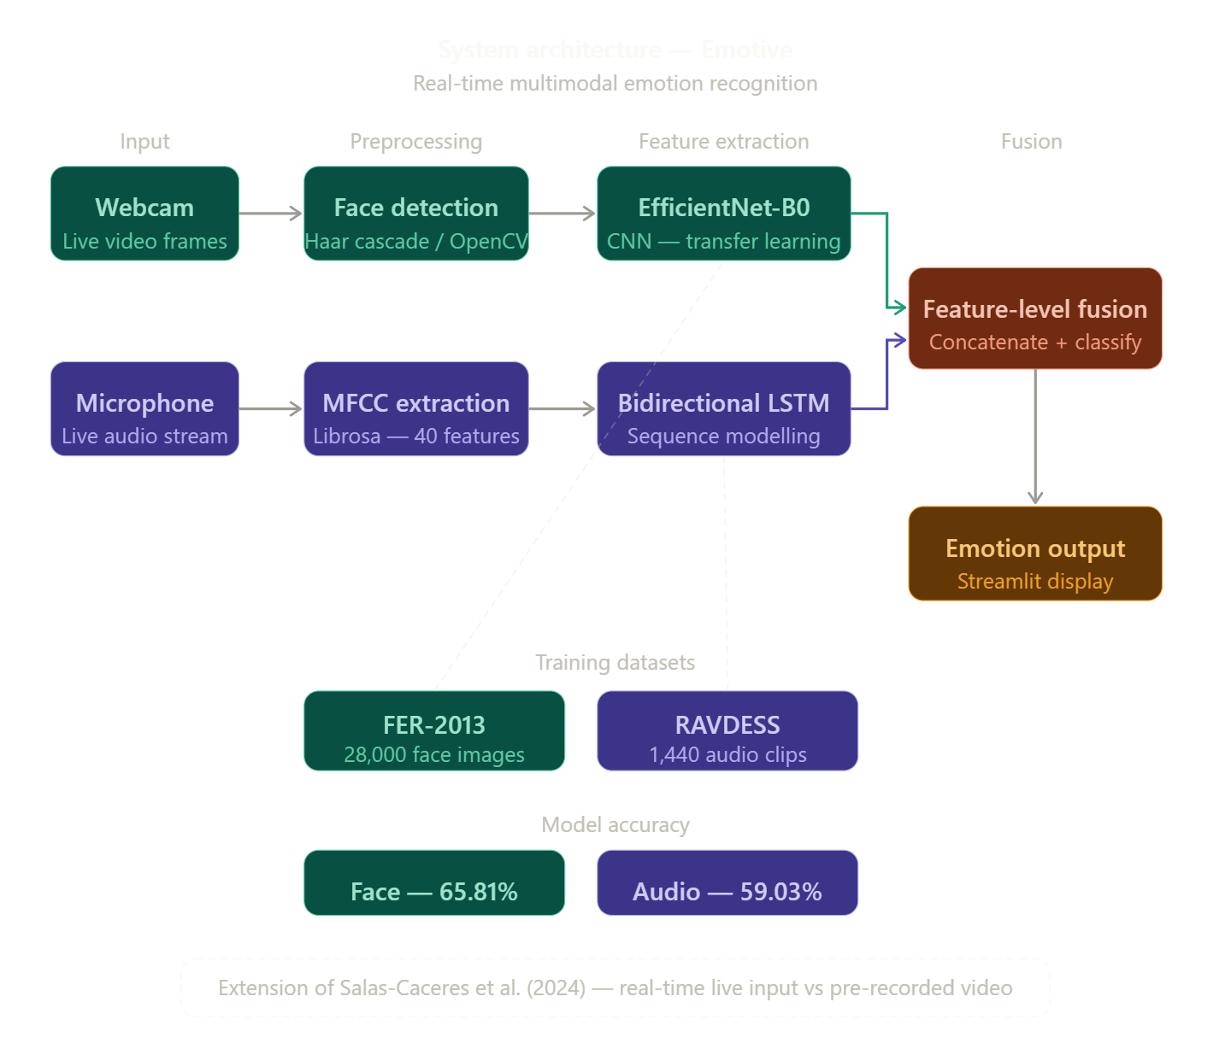
SYSTEM ARCHITECTURE
The system uses a parallel dual-pipeline architecture. The webcam stream feeds into EfficientNet-B0 for facial emotion detection, while the microphone stream is processed by the LSTM audio model. Both models output softmax probability vectors which are combined via a simple feature fusion layer to produce the final emotion label, displayed in real time on the Streamlit interface.

Slide 4
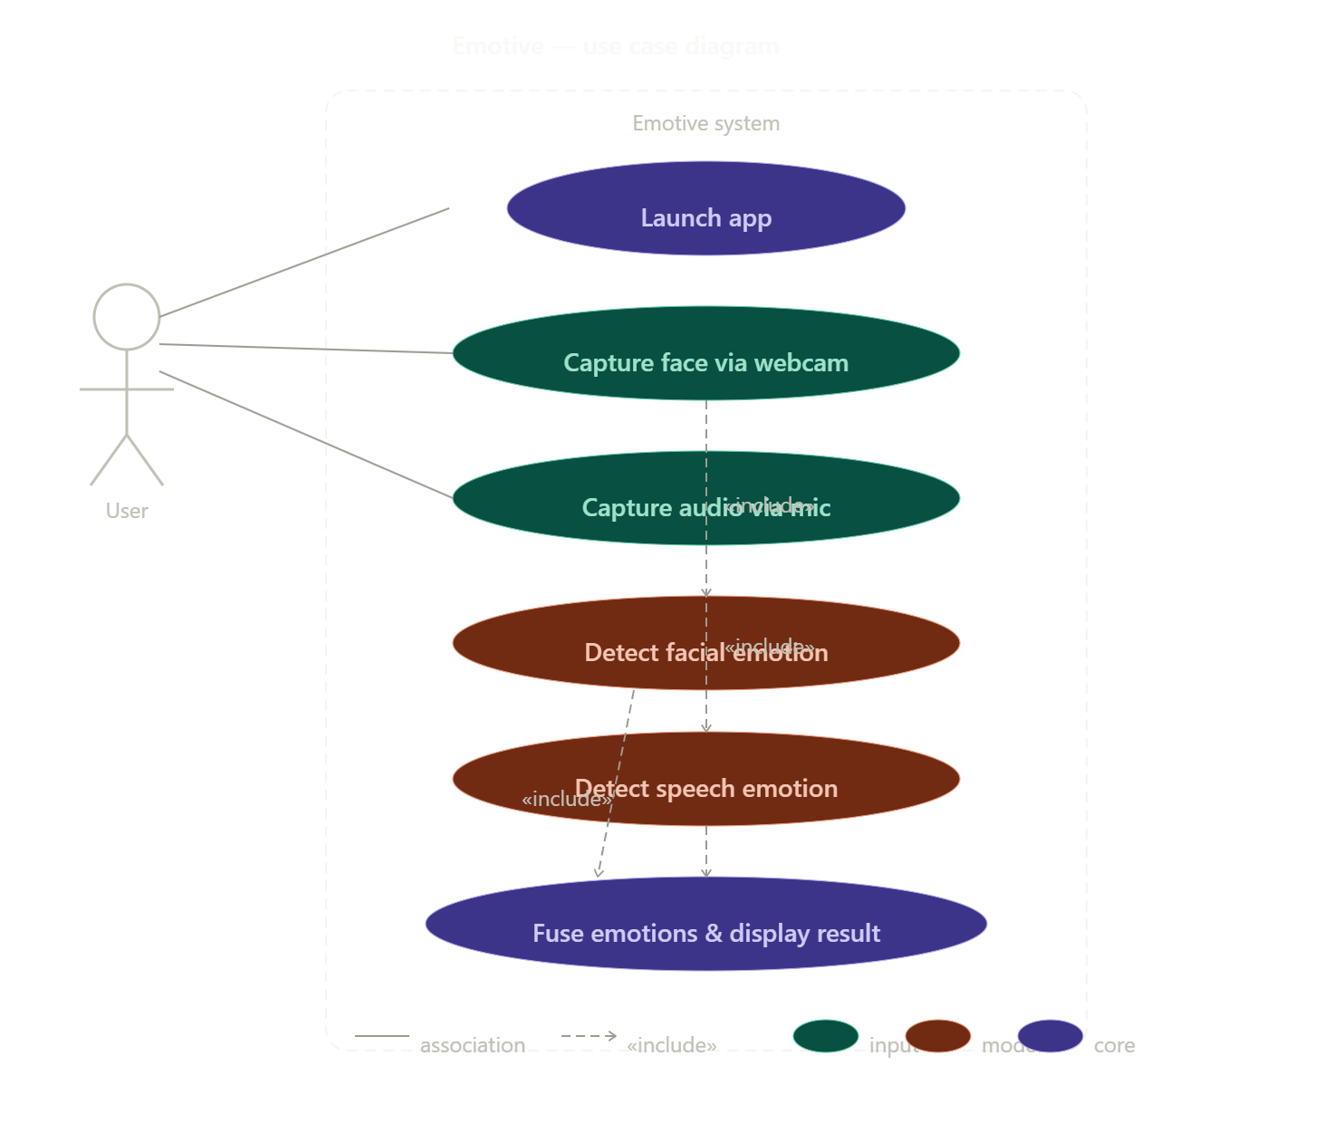
USE CASE DIAGRAM
Three actors interact with the system: the End User who starts a session and views emotion output; the AI Engine which captures frames and audio, runs inference, and fuses results; and the Admin who manages model versions and session logs. Key use cases include: Start Session, Capture Frame, Detect Facial Emotion, Detect Audio Emotion, Fuse Results, Display Output, and Manage Models.

Slide 5
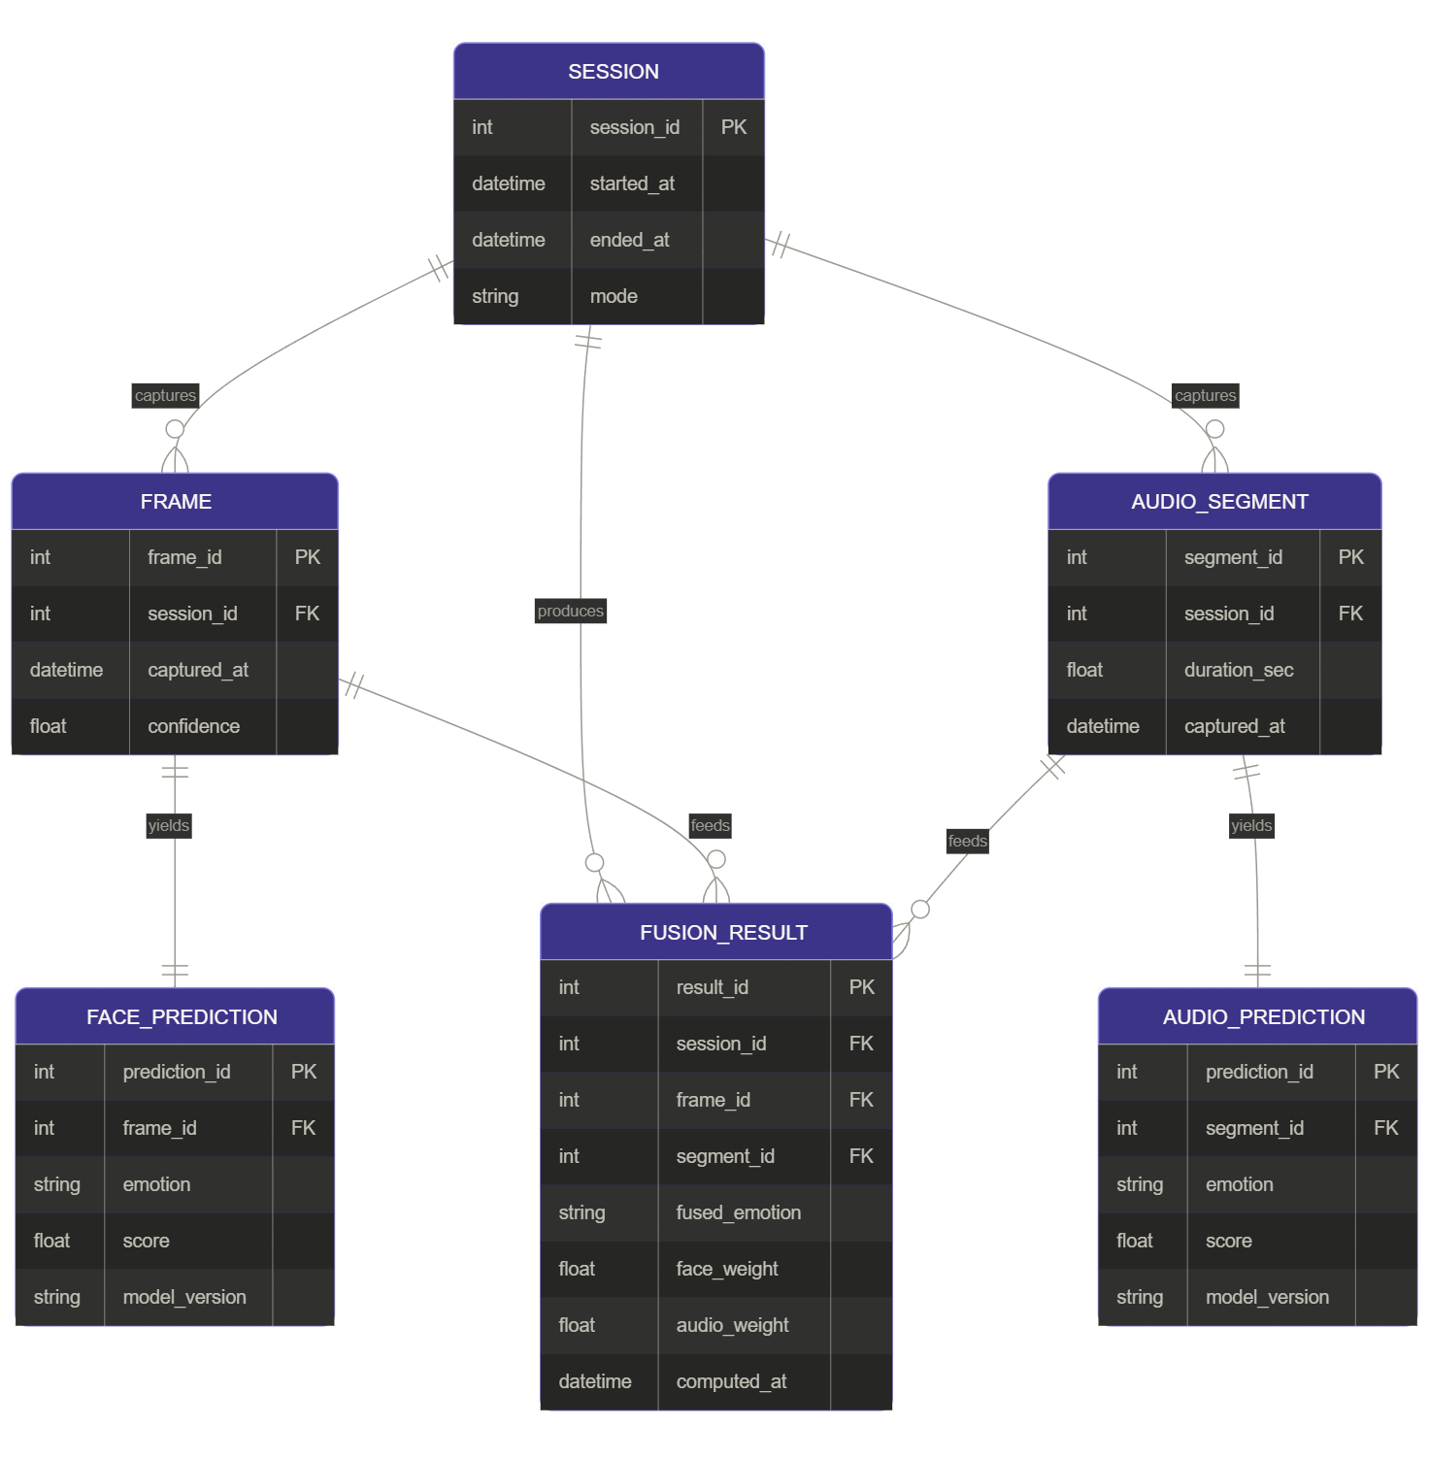
ER DIAGRAM
Five core entities: Session (session_id, timestamp, user_id), FaceResult (result_id, session_id, frame_no, predicted_emotion, confidence), AudioResult (result_id, session_id, segment_no, predicted_emotion, confidence), FusedResult (fused_id, session_id, final_emotion, face_weight, audio_weight), and ModelMetadata (model_id, modality, version, accuracy, trained_on). All result tables relate to Session via session_id.

Slide 6
METHODOLOGY
Data Collection
Model Training
01
FER-2013: 35,887 labelled 48×48 facial images, 7 classes.
RAVDESS: 1,440 audio recordings from 24 actors, 8 emotions.
03
EfficientNet-B0 (transfer learning, fine-tuned top layers).
LSTM (2 layers, 128 units). Adam optimizer, cross-entropy loss.
Preprocessing
Fusion & Output
02
Face: Haar cascade → crop → resize 48×48 → normalize.
Audio: MFCC (40 coefficients, 130 timesteps) → z-score normalize.
04
Late fusion: softmax vectors from both models combined via weighted average. argmax gives final emotion label shown live.

Slide 7
MODEL PERFORMANCE
Facial Emotion Model
Audio Emotion Model
65.81%
59.03%
Validation Accuracy
Validation Accuracy
EfficientNet-B0 (Transfer Learning)
FER-2013 — 35,887 images
7 emotion classes
Adam optimizer
Input: 48×48 grayscale crops
LSTM (2 layers, 128 units)
RAVDESS — 1,440 samples
MFCC: 40 coeff, 130 timesteps
Adam optimizer
Input: 3-second audio window

Slide 8
CORE FUNCTIONALITIES
Real-Time Face Detection
Real-Time Audio Analysis
Multimodal Fusion
Haarcascade detects face ROI per frame. EfficientNet classifies into 7 emotions with confidence score.
3-second audio windows sampled from mic. MFCC features extracted and fed into LSTM for prediction.
Softmax outputs from both models merged via weighted late fusion. α weight is tunable per context.
Live Streamlit Dashboard
Session Logging
7-Class Emotion Output
Single-page app streams webcam + mic, shows emotion label and confidence in real time.
Frame-level and segment-level predictions, fused results, and model version stored per session.
Angry, Disgust, Fear, Happy, Neutral, Sad, Surprise — mapped across FER-2013 and RAVDESS labels.

Slide 9
IMPLEMENTATION STACK
Deep Learning
Data & Features
App & Infra
Python 3.10
TensorFlow / Keras
EfficientNet-B0 (TF Hub)
LSTM (Keras Sequential)
NumPy / Pandas
FER-2013 Dataset
RAVDESS Dataset
OpenCV (face detection)
Librosa (MFCC extraction)
Scikit-learn (preprocessing)
Streamlit (UI framework)
PyAudio (mic capture)
OpenCV VideoCapture
SQLite (session logs)
GitHub (version control)

Slide 10
TESTING & VALIDATION
Test Type | What Was Tested | Outcome
Unit Testing | MFCC extraction, face crop, model predict() | All functions return correct shape & dtype
Integration Testing | Camera → detection → model → fusion → display | End-to-end pipeline runs without errors
Model Validation | Val set on FER-2013 and RAVDESS | 65.81% face accuracy, 59.03% audio accuracy
Fusion Testing | Weighted combination with α = 0.6 / 0.4 | Fused output more stable than single modality
Live Demo Testing | Real webcam + mic on laptop hardware | Real-time inference at ~15–20 FPS

Slide 11
FUTURE SCOPE
01 Improve Accuracy
02 Temporal Fusion
03 Cloud Deployment
More epochs, data augmentation, larger datasets (AffectNet, IEMOCAP) to push beyond current baselines.
Analyze emotion over a sliding time window instead of frame-by-frame for better emotional dynamics.
Move from local Streamlit to cloud-hosted web app (AWS / GCP) for broader access and scalability.
04 More Modalities
05 Model Optimization
06 Domain Applications
Incorporate body language, eye gaze, and physiological signals for richer multimodal understanding.
Apply quantization and pruning for faster inference on edge and mobile devices.
Driver drowsiness detection, mental health monitoring, e-learning engagement tracking. We will tune this in one direction.

Slide 12
CONCLUSION
Successfully built a real-time multimodal emotion recognition system
EfficientNet-B0 achieves 65.81% accuracy on FER-2013 (facial model)
LSTM achieves 59.03% accuracy on RAVDESS (audio model)
Live Streamlit MVP fuses both modalities end-to-end
System architecture, use case, and ER diagrams completed
Strong foundation for future accuracy improvements and cloud deployment
Thank You

